Slide 1




Regular Expressions (RegEx)
Regular Expressions Language Syntax
Advanced Text Processing with RegEx
Programming Fundamentals
SoftUni Team
Technical Trainers
Software University
http://softuni.bg

Slide 2

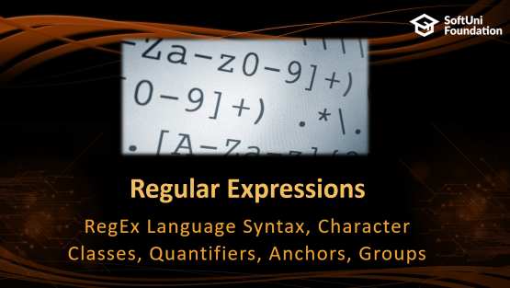
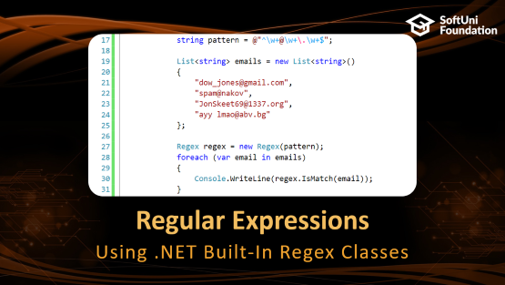

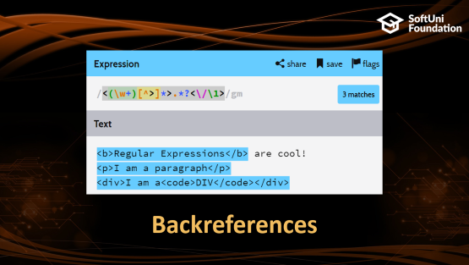



Table of Contents

Slide 3
Have a Question?
sli.do #fund-softuni

Slide 4
Regular Expressions
RegEx Language Syntax, Character Classes, Quantifiers, Anchors, Groups

Slide 5

What are Regular Expressions?
Regular expressions (regex)
Match text by pattern
Patterns are defined by special syntax, e.g.
[0-9]+ matches non-empty sequence of digits
[A-Z][a-z]* matches a capital + small letters
\s+ matches whitespace (non-empty)
\S+ matches non-whitespace
Play with regex live at: regexr.com, regex101.com, regextester.com

Slide 6
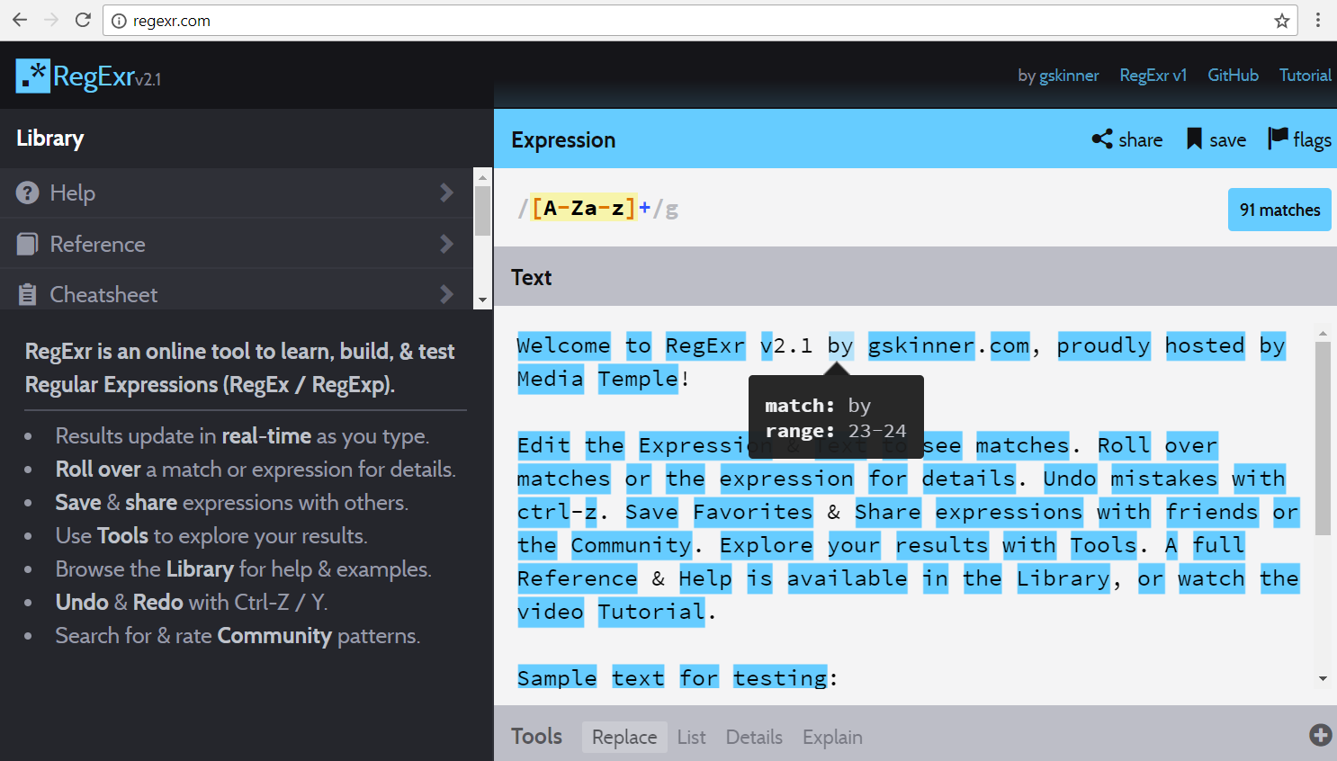
Playing with regexr.com
Live Demo

Slide 7
Regular Expression Pattern – Example
Regular expressions (regex) describe a search pattern
Used to find / extract / replace / split data from text by pattern
[A-Z][a-z]+ [A-Z][a-z]+ - \w+@\w+\.\w+
matches
Ivan Ivanov - ivan@gmail.com
Petar Iotov - petar@abv.bg
Contact: Alex Georgiev - alex@mail.com …
Test your regex here: http://regexr.com/3g8gc

Slide 8
Character Classes: Ranges
[nvj] matches any character that is either n, v or j
[^abc] – matches any character that is not a, b or c
[0-9] – character range: matches any digit from 0 to 9
node.js v0.12.2
Abraham Lincoln
In 1519 Leonardo da Vinci died at the age of 67.

Slide 9
Character Classes: Predefined
\w – matches any word character (a-z, A-Z, 0-9, _)
\W – matches any non-word character (the opposite of \w)
\s – matches any white-space character
\S – matches any non-white-space character (opposite of \s)
\d – matches any decimal digit
\D – matches any non-decimal digit (opposite of \d)
aBcd 09_ &*^
aBcd 09_ &*^
Notes:
\w – Matches any word character (a-z, A-Z, 0-9, _)
\W – Matches any non-word character (the opposite of \w)
\s – Matches any white-space character
\S – Matches any non-white-space character (opposite of \s)
\d – Matches any decimal digit
\D – Matches any non-digit character (opposite of \d)

Slide 10
Quantifiers
* – matches the previous element zero or more times
+ – matches the previous element one or more times
? – matches the previous element zero or one time
{3} – matches the previous element exactly 3 times
\+\d*
+359885976002 a+b
\+\d+
+359885976002 a+b
\+\d?
+359885976002 a+b
\+\d{3}
+359885976002 a+b

Slide 11
Character Escapes
Sometimes we need to look for special characters like new lines, tabs, dots, slashes, brackets, etc.
Use character escaping in the RegEx like this:
This is a “tab”
A new line comes at the end
Name: Peter
Phone: +359882042353
Name:\t\w+\nPhone:\s*\+\d+

Slide 12

Anchors
^ – the match must start at the beginning of the text or line
$ – the match must occur at the end of the text or line
Example – username validation pattern:
Use multiline matching (/m flag) to match the end of line
^\w{6,12}$
jeff_butt
short
johnny
too_long_username
!lleg@l_ch@rs

Slide 13


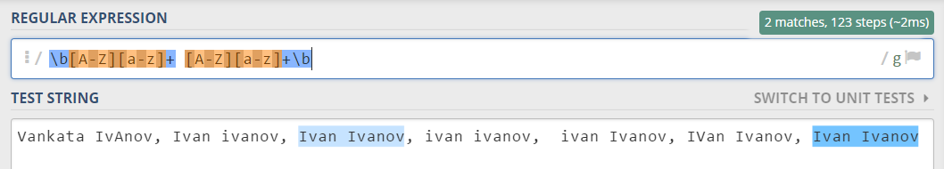
Problem: Match a Full Name
You are given a sequence of words
Find those which are full names
A full name consists of two words (space-separated)
Word are: uppercase latin letter + several lowercase latim letters
Use online regex matcher like RegXr or Regex101

Slide 14
Grouping Constructs
(subexpression) – captures the matched subexpression as numbered group
(?:subexpression) – defines a non-capturing group
(?<name>subexpression) – defines a named capturing group
\d{2}-(\w{3})-\d{4}
22-Jan-2015
^(?:Hi|hello),\s*(\w+)$
Hi, Peter
(?<day>\d{2})-(?<month>\w{3})-(?<year>\d{4})
22-Jan-2015

Slide 15
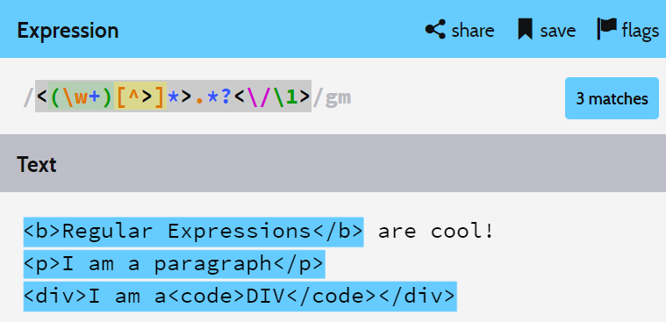
Backreferences

Slide 16
Backreferences Match Previous Groups
\number – matches the value of a numbered capture group
<(\w+)[^>]*>.*?<\/\1>
<b>Regular Expressions</b> are cool!
<p>I am a paragraph</p> … some text after
Hello, <div>I am a<code>DIV</code></div>!

Slide 17

Playing with RegEx
Exercises in Class

Slide 18
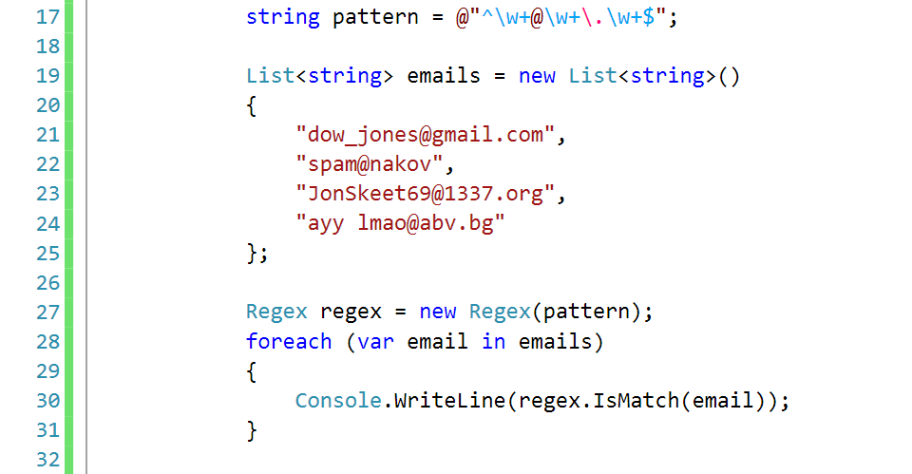
Regular Expressions
Using .NET Built-In Regex Classes

Slide 19
Regex in C#
C# supports a built-in regular expression class: Regex
Located in System.Text.RegularExpressions namespace
using System.Text.RegularExpressions;
static void Main()
{
string pattern = @"A\w+";
Regex regex = new Regex(pattern);
}

Slide 20
Validating String By Pattern
IsMatch(string text)
Determines whether the text matches given pattern
string text = "Today is 2015-05-11";
string pattern = @"\d{4}-\d{2}-\d{2}";
Regex regex = new Regex(pattern);
bool containsValidDate = regex.IsMatch(text);
Console.WriteLine(containsValidDate); // True

Slide 21
Checking for a Single Match
Match(string text)
Рeturns the first match of given pattern
string text = "Nakov: 123";
string pattern = @"([A-Z][a-z]+): (\d+)";
Regex regex = new Regex(pattern);
Match match = regex.Match(text);
Console.WriteLine(match.Groups.Count); // 3
Console.WriteLine("Matched text: \"{0}\"", match.Groups[0]);
Console.WriteLine("Name: {0}", match.Groups[1]); // Nakov
Console.WriteLine("Number: {0}", match.Groups[2]); // 123

Slide 22
Checking for Matches
Matches(string text) – returns a collection of matches
string text = "Nakov: 123, Branson: 456";
string pattern = @"([A-Z][a-z]+): (\d+)";
Regex regex = new Regex(pattern);
MatchCollection matches = regex.Matches(text);
Console.WriteLine("Found {0} matches", matches.Count);
foreach (Match match in matches)
Console.WriteLine("Name: {0}", match.Groups[1]);
// Found 2 matches
// Name: Nakov
// Name: Branson

Slide 23
Replacing With Regex
Replace(string text, string replacement) – replaces all strings that match the pattern with the provided replacement
string text = "Nakov: 123, Branson: 456";
string pattern = @"\d{3}";
string replacement = "999";
Regex regex = new Regex(pattern);
string result = regex.Replace(text, replacement);
Console.WriteLine(result);
// Nakov: 999, Branson: 999

Slide 24
Problem: Replace <a> tag
You are given some html text
Replace all <a> tags in it with [URL]
<ul> <li> <a href="http://softuni.bg">SoftUni</a></li></ul>
<ul> <li> [URL href="http://softuni.bg"]SoftUni[/URL]</li></ul>
Check your solution here: https://judge.softuni.bg/Contests/Practice/Index/320#4

Slide 25
Solution: Replace <a> tag
string text = Console.ReadLine();
while (text != "end")
{
string pattern = @"<a.*?href.*?=(.*)>(.*?)<\/a>";
string replacement = @"[URL href=$1]$2[/URL]";
string replaced = Regex.Replace(
text, pattern, replacement);
Console.WriteLine(replaced);
text = Console.ReadLine();
}
Notes:
You can try also: @"<a.*href=((?:.|\n)*?(?=>))>((?:.|\n)*?(?=<))<\/a>"

Slide 26
Splitting With Regex
Split(string text) – splits the text by the pattern
Returns string[]
string text = "1 2 3 4";
string pattern = @"\s+";
string[] results = Regex.Split(text, pattern);
Console.WriteLine(string.Join(", ", results));
// 1, 2, 3, 4

Slide 27
Built-in RegEx .NET API
Exercises in Class

Slide 28


Summary
Regular expressions describe patterns for searching through text
Define special characters, operators and constructs for building complex pattern
Can utilize character classes, groups, quantifiers and more
Using RegEx in C#
Matching strings, separating by match groups, Splitting by RegEx

Slide 29







Programming Fundamentals – Objects & Classes
https://softuni.bg/courses/programming-fundamentals

Slide 30
License
This course (slides, examples, demos, videos, homework, etc.) is licensed under the "Creative Commons Attribution-NonCommercial-ShareAlike 4.0 International" license

Slide 31





Trainings @ Software University (SoftUni)
Software University – High-Quality Education, Profession and Job for Software Developers
softuni.bg
Software University Foundation
http://softuni.foundation/
Software University @ Facebook
facebook.com/SoftwareUniversity
Software University Forums
forum.softuni.bg

